Slide 1
Why CNN is Better than ANN

Slide 2
Why?
Sparse Connectivity
Weight Sharing

Slide 3
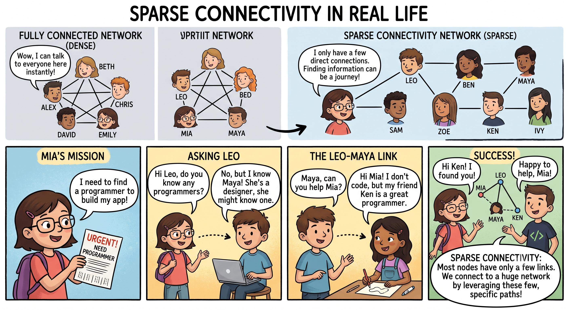

Slide 4
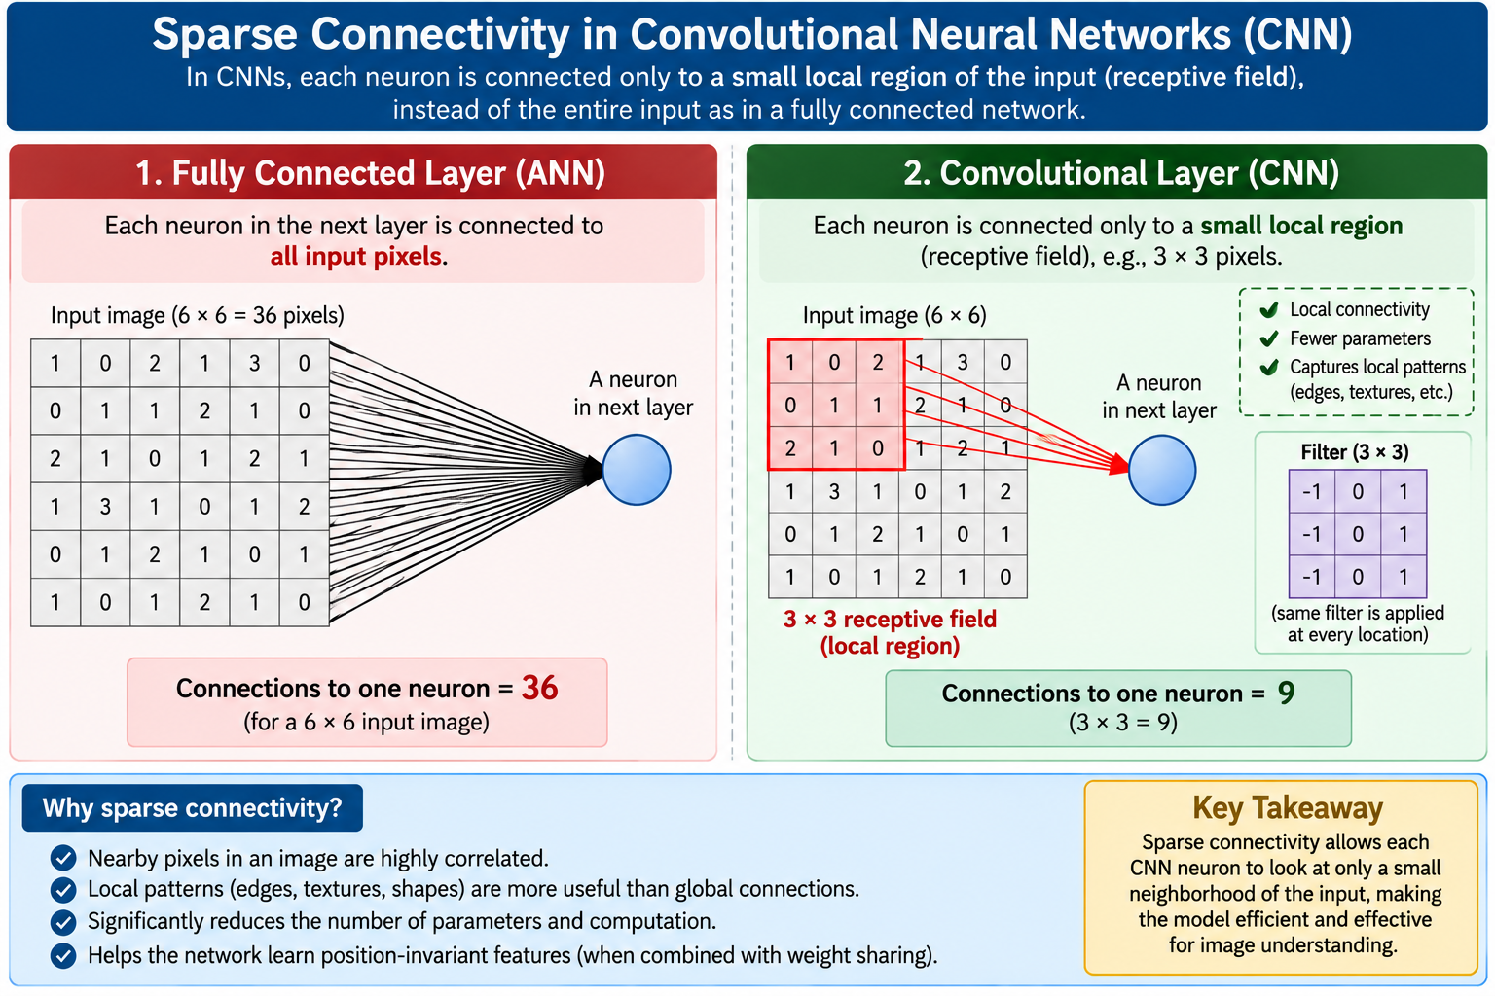

Slide 5
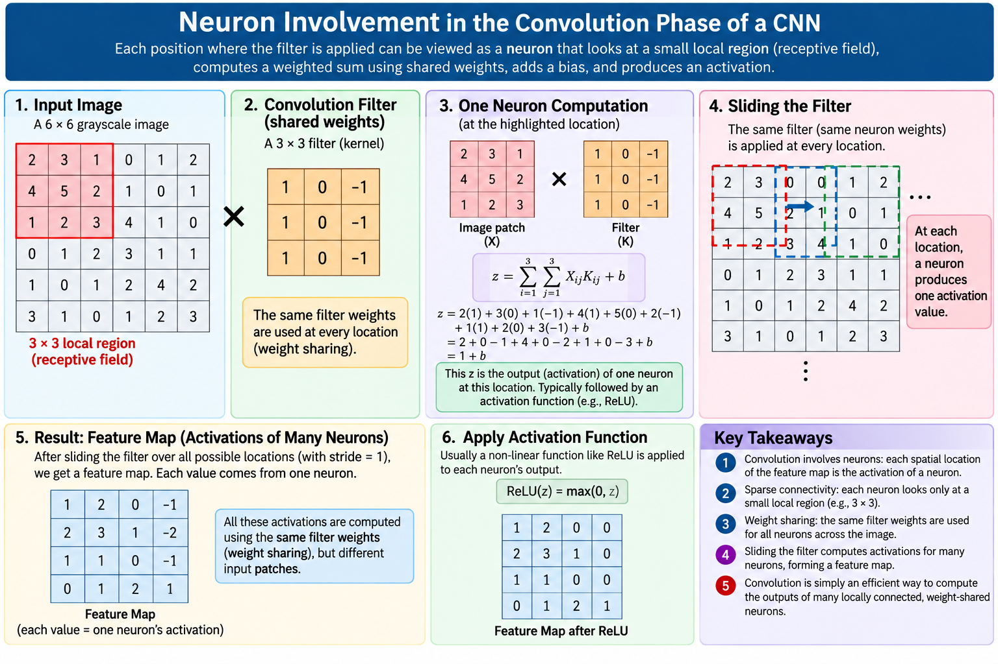

Slide 6
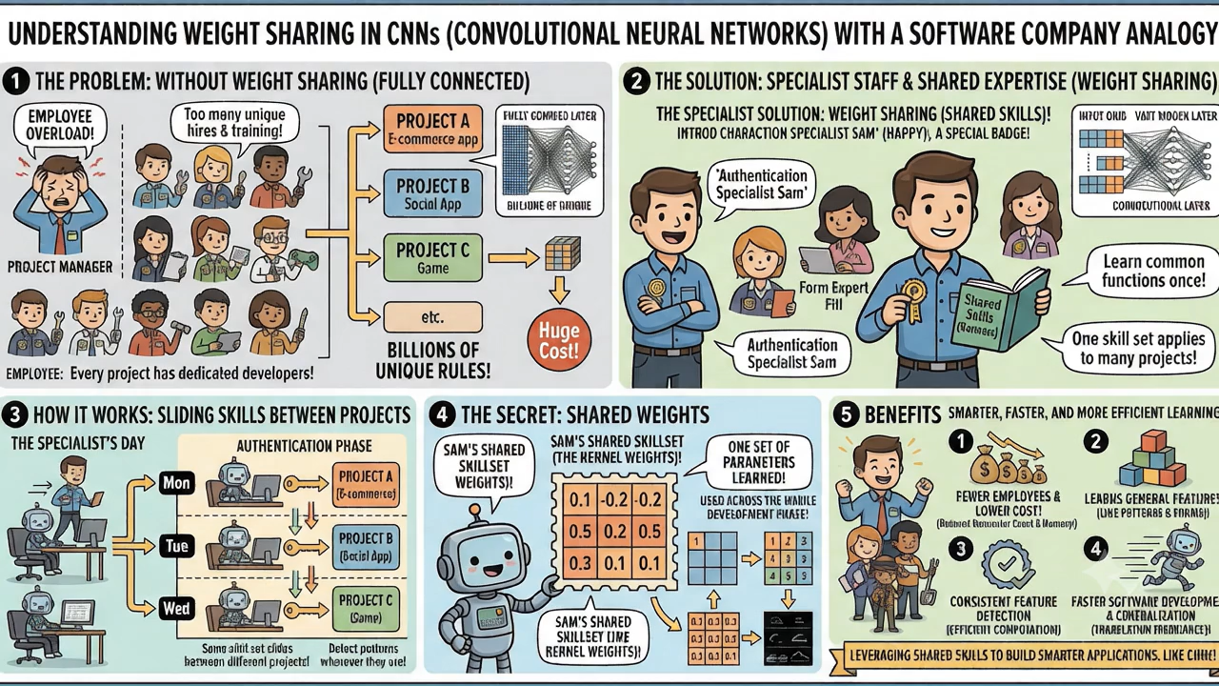

Slide 7
